Slide 1

Deep Learning to Detect Computer-Generated Reviews in E-Commerce
Han Chau - 20012654

Slide 2
Content
Problem and research question
Data description and insights
Data pre-processing
Method
Analysis and results
Conclusion

Slide 3

Problem and research question
In the e-commerce space, reviews and comments have a significant impact on sellers' and products' reputations. However, the popularity of fraudulent reviews calls into question the reliable of online platforms, creating significant difficulty for users to discern between genuine and useful content.
To what extent can deep learning models accurately distinguish between reviews authored by humans and those generated by computers?
How does the incorporation of advanced natural language processing techniques impact the accuracy of detecting fake reviews?

Slide 4

Data description and insights
There are 2 datasets:
Fake Review Dataset: sourced from Kaggle, consists of 40,412 reviews generated by both humans and computers.
Amazon review dataset: containing several million Amazon reviews and is currently unlabeled, providing an extensive and unexplored dataset for potential analysis and model training.

Slide 5
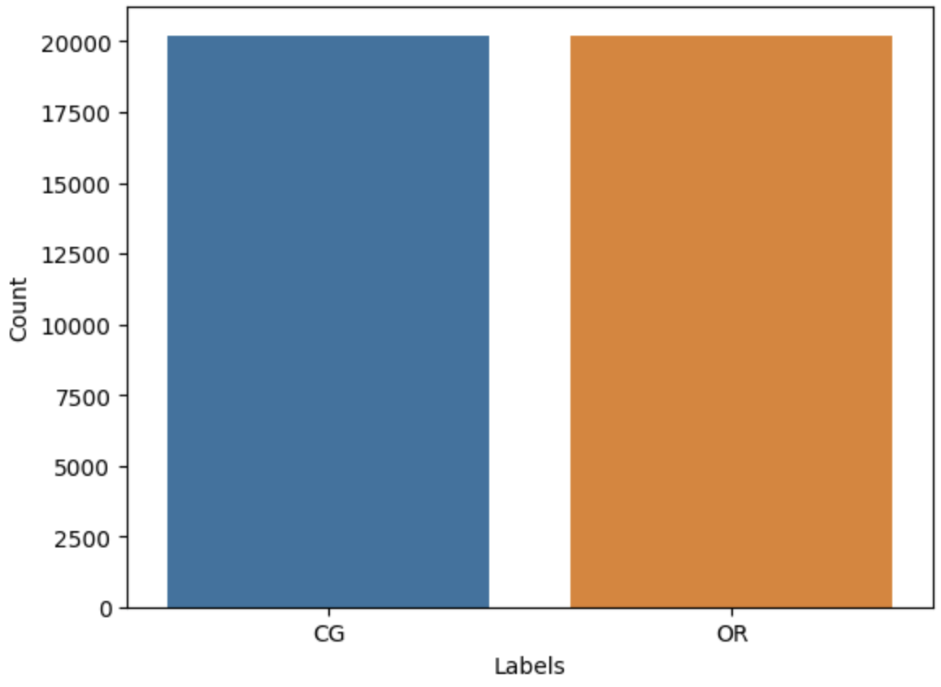
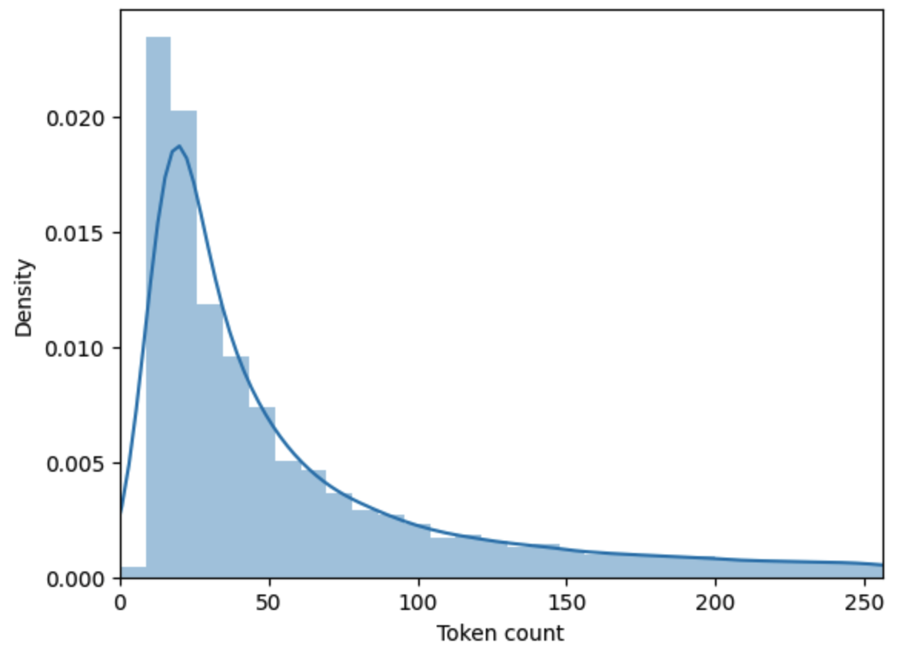
Fake Review Dataset
Figure: The histogram of Labels
Figure: The distribution of review length

Slide 6
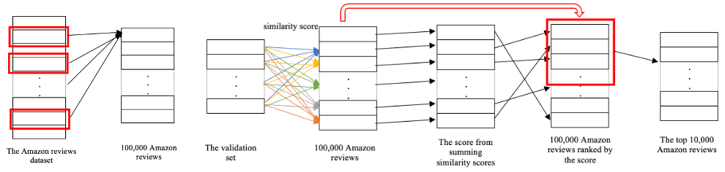
Amazon Review Dataset
Figure: Creating a new dataset with a size of 10,000 Amazon reviews

Slide 7
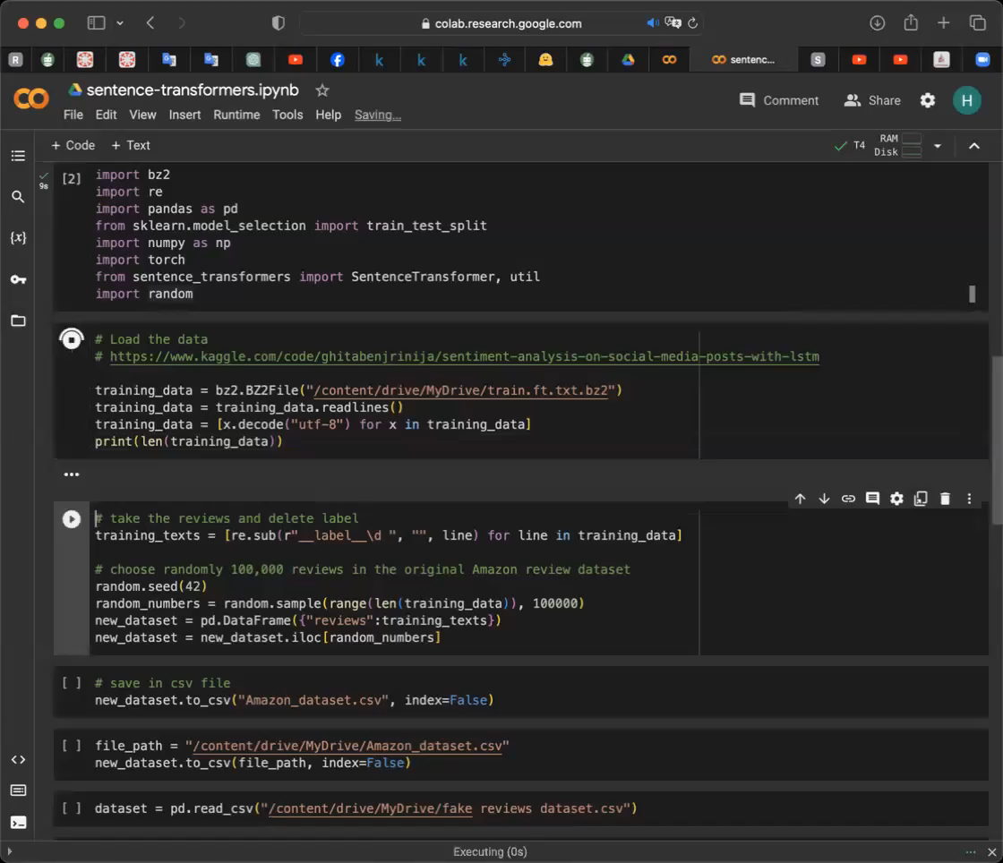
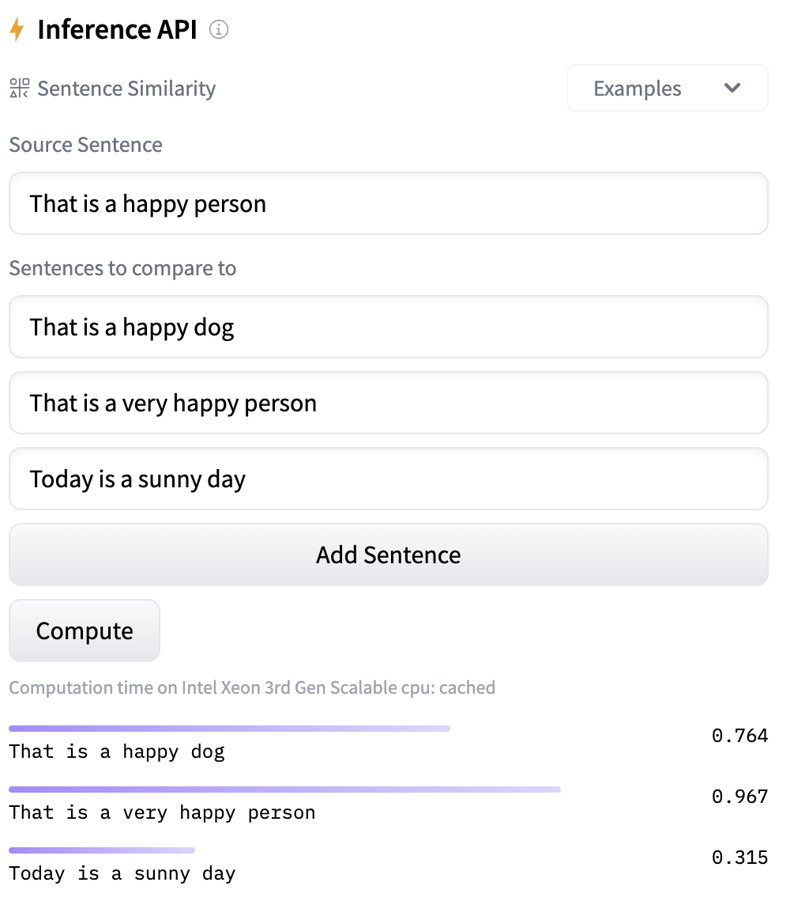
Amazon Review Dataset
Using 'all-mpnet-base-v2', a sentence-transformers model, to map sentences to a 768 dimensional dense vector space. This facilitates applications such as clustering or determining sentence similarity using cosine similarity.
Since the vectors are normalized, the dot-product and cosine-similarity are equivalent. The dot-product (util.dot_score) is preferred as it is faster.
Source: https://huggingface.co/sentence-transformers/all-mpnet-base-v2

Slide 8
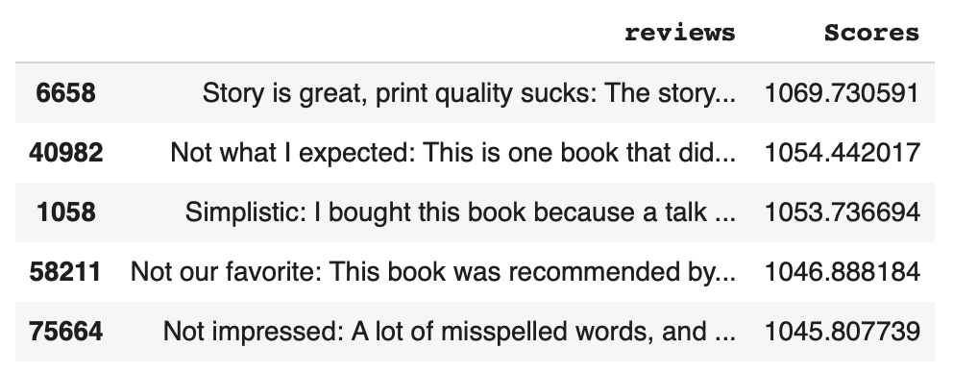
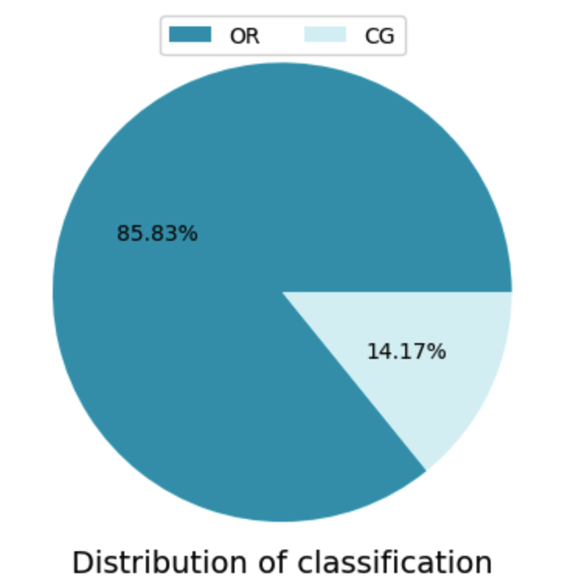
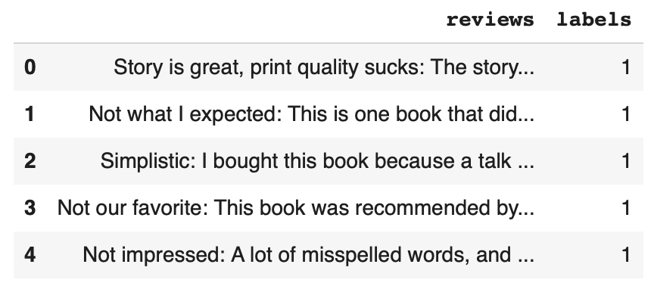
Amazon Review Dataset

Slide 9
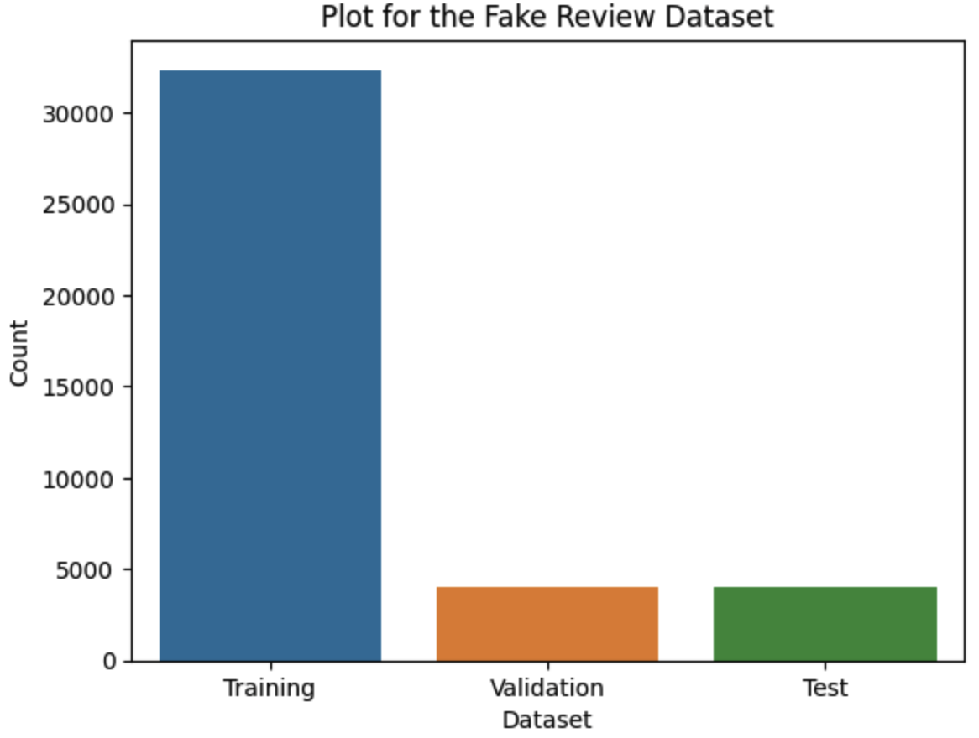
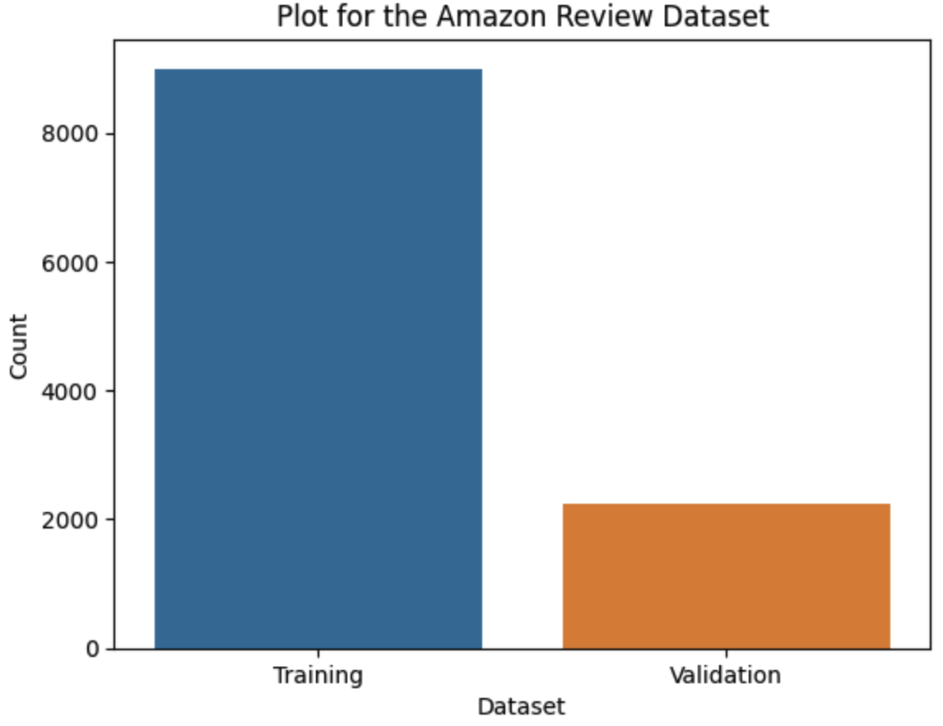
Data Pre-processing

Slide 10
Data Pre-processing
Dataset and DataLoader:
Utilizing PyTorch's Dataset and DataLoader functionalities for efficient data handling.
Enabling batch loading, shuffling, and parallel data loading using multiple workers for streamlined processing.
AutoTokenizer from Hugging Face:
Employing Hugging Face's AutoTokenizer to simplify the text tokenization process.
Dynamically selecting an appropriate tokenizer for the specified pre-trained model without manual intervention.
Notes:
Datasets and DataLoaders play pivotal roles in facilitating efficient data loading and iteration for machine learning tasks, specifically deep learning
As system limitations are a consideration, batch loading is optimized to reduce computational time and memory usage

Slide 11
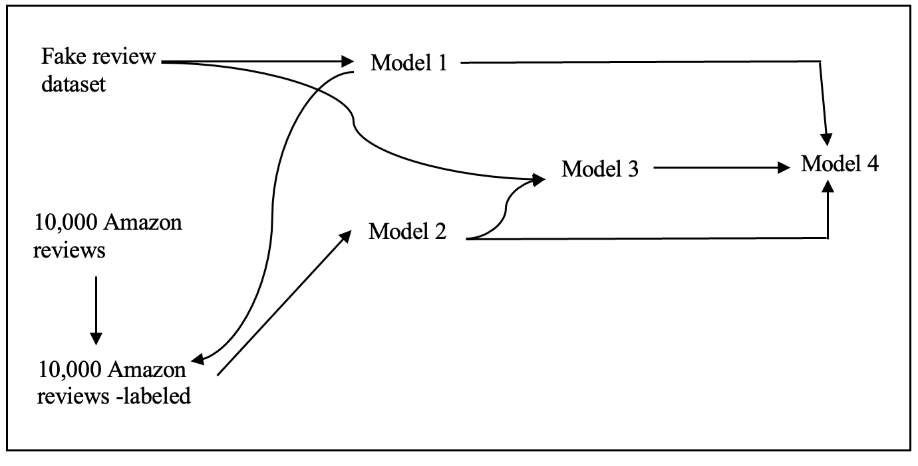
Method
Notes:
By utilizing the pre-trained model, known Model 2, as a starting point for Model 3, I leverage the knowledge and features learned during the previous training, potentially enhancing the model's ability to generalize patterns in the original data. The pre-trained model (Model 2) can act as a feature extractor, capturing relevant information from the Amazon dataset. This extracted knowledge can then be fine-tuned on the original dataset, potentially improving the model's performance on the specific task of distinguishing between human and computer-generated reviews.

Slide 12
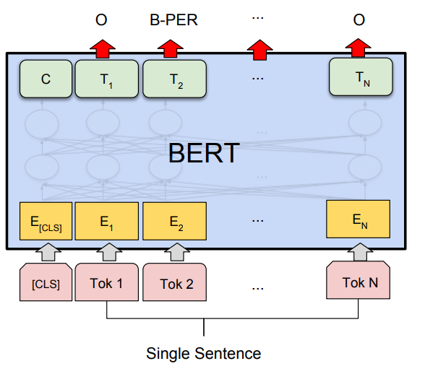
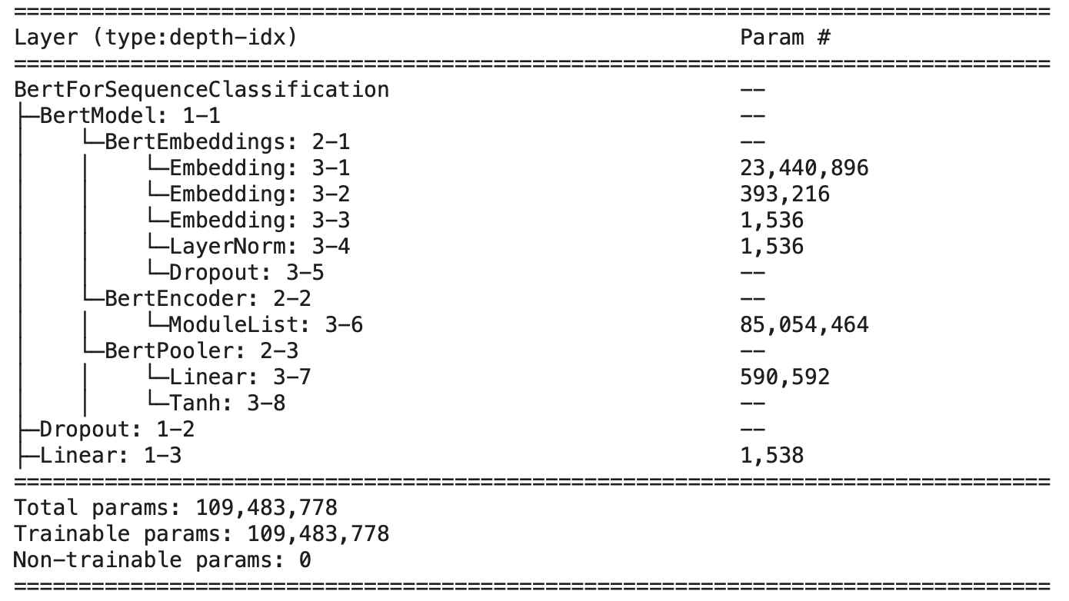
Model Architecture:
The BERT architecture from the Hugging Face Transformers library, specifically the AutoModelForSequenceClassification on 'bert-base-uncased’.
Fine-tuning the models using an AdamW optimizer for optimization integrated with a linear schedule, dynamically decreasing the learning rate.

Slide 13
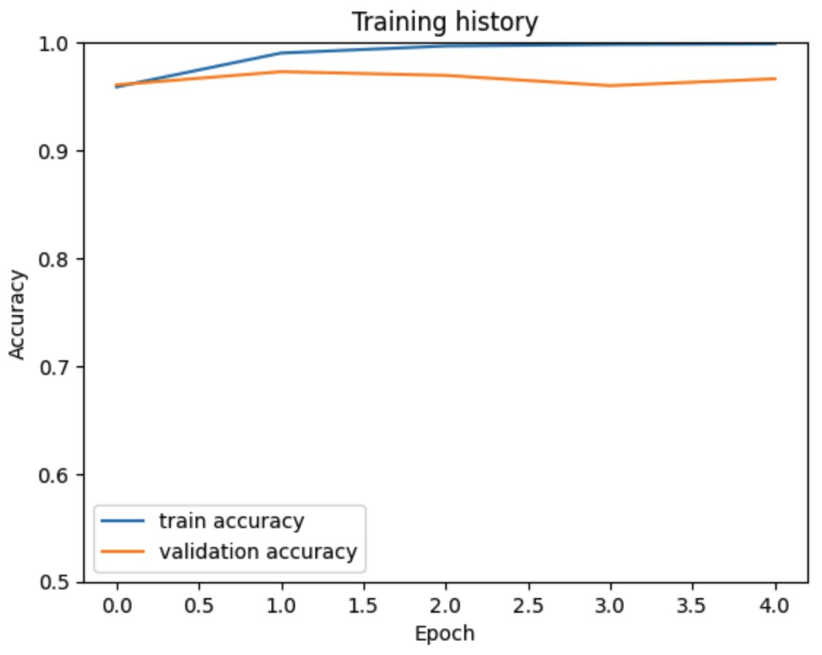
Model 1:
Parameter Settings:
Setting max_len to 150 and batch_size to 64 for effective text tokenization and model training.
An AdamW optimizer integrating a learning rate of 2e-5 with a linear schedule, gradually decreasing from the initial value
Training Duration: The model underwent training for a total of 5 epochs, allowing it to learn patterns and features from the dataset.

Slide 14
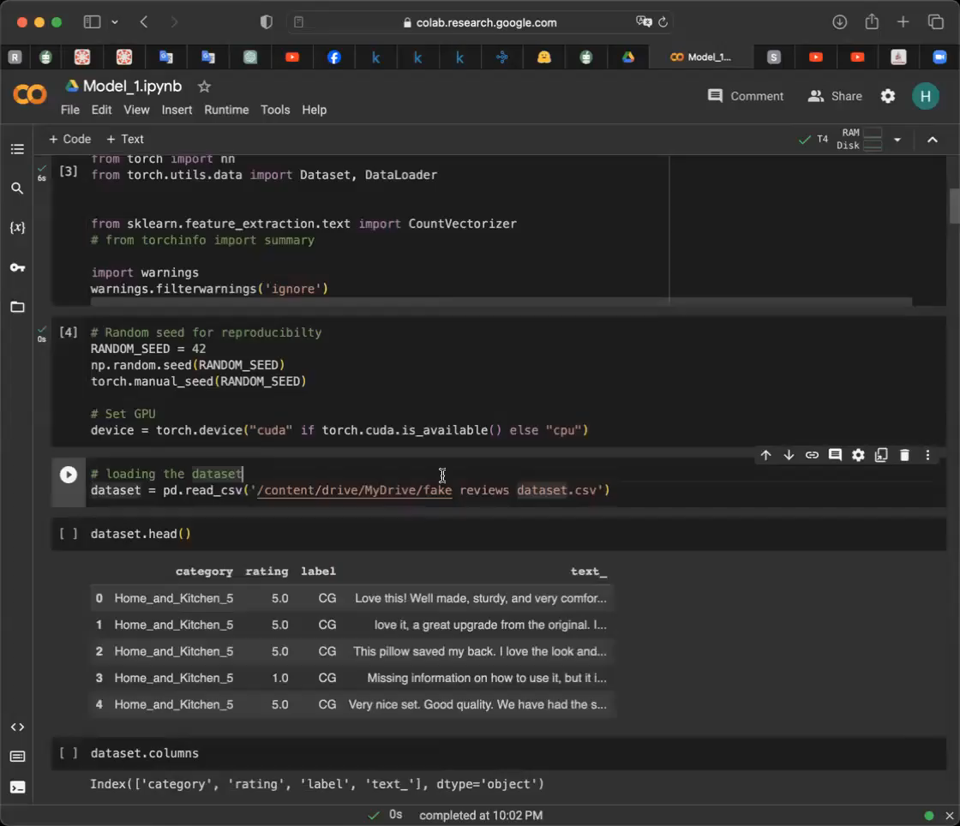
Model 1:
https://huggingface.co/docs/transformers/training

Slide 15
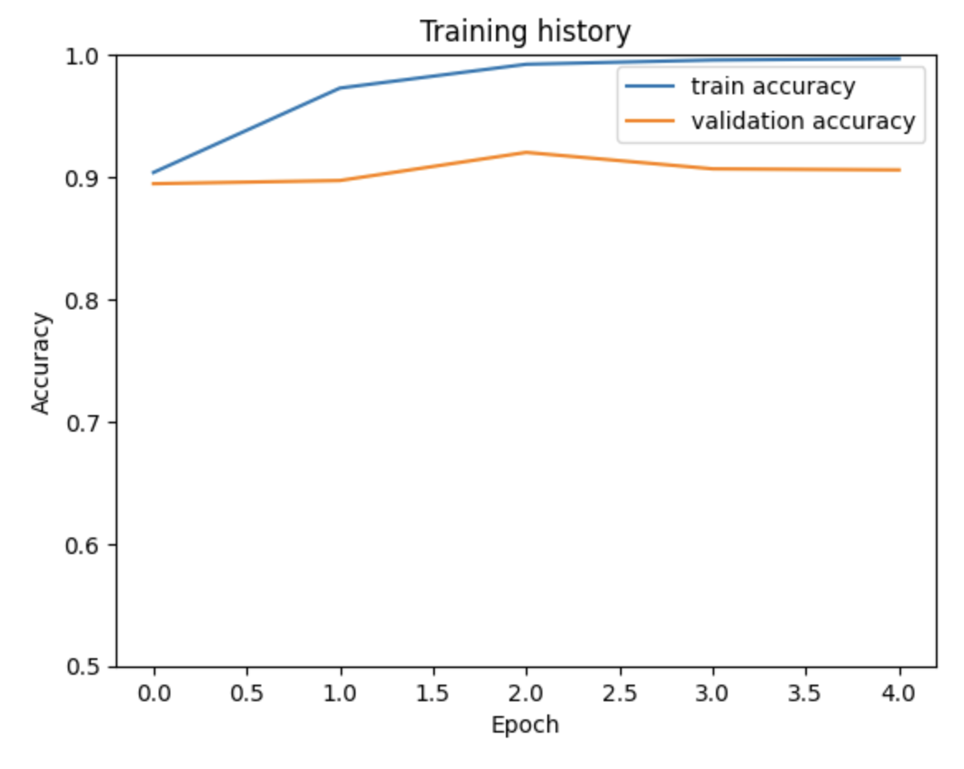
Model 2:
Leveraging the labeled Amazon dataset obtained from Model 1 for training.
Setting max_len to 160 for effective text tokenization.
The model undergoes training, similar to Model 1, with a duration optimized for effective learning.

Slide 16
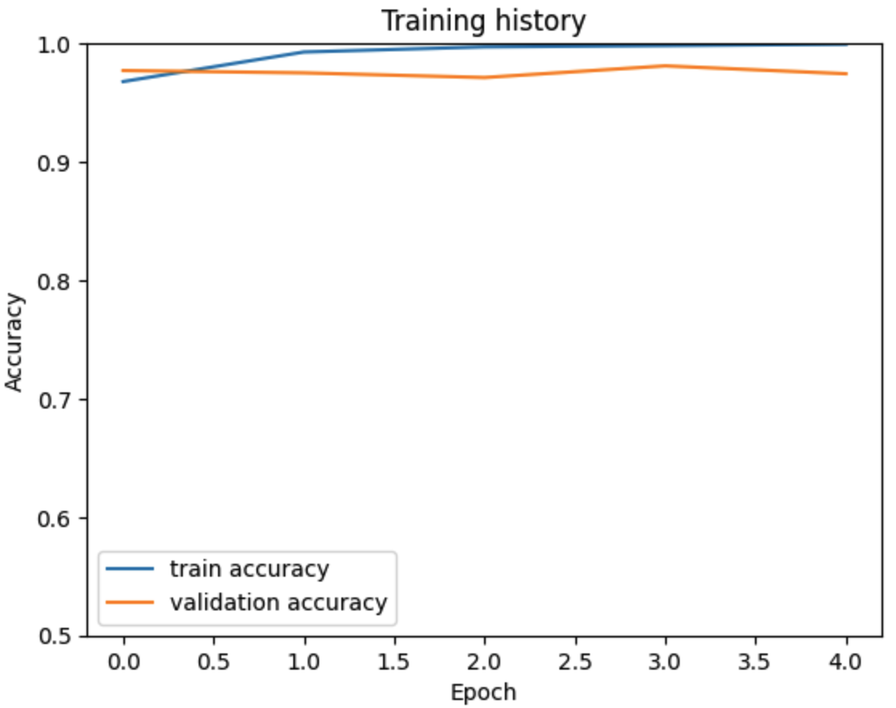
Model 3:
Utilizing a fine-tuned BERT model, specifically Model 2, as a pre-trained model for Model 3 on the original dataset as the training dataset.
The fine-tuning process with a max review length set to 160, a batch size of 32, an optimizer, and learning rate scheduler.

Slide 17
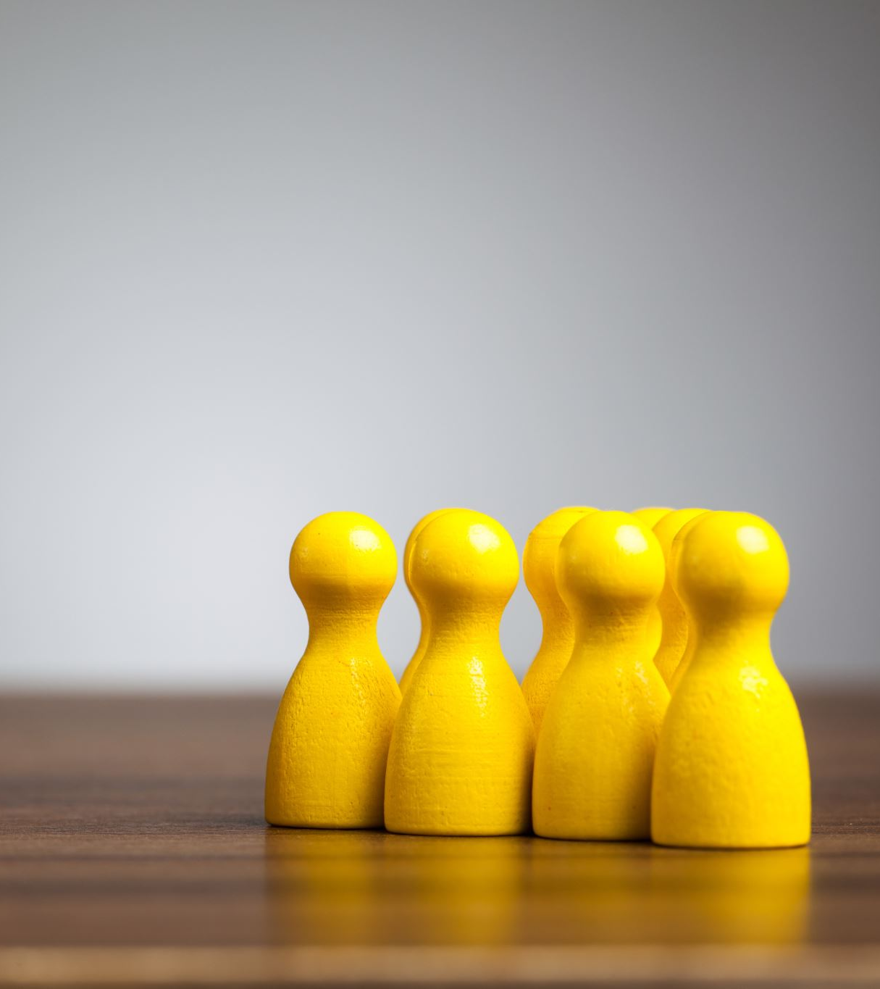
Model 4
Leveraging the collective decision-making power of individual models to enhance overall prediction accuracy.
The final prediction is determined by the majority vote among the three models.

Slide 18

Analysis and Result
Model 1: 97.53%
Model 2: 84.25%
Model 3: 97.58%
Model 4: 97.55%
 | Accuracy | Precision | Recall | F1
Model 1 | 97.53% | 96.15% | 99.01% | 97.56%
Model 2 | 84.25% | 77.00% | 97.77% | 86.15%
Model 3 | 97.58% | 96.06% | 99.21% | 97.60%
Model 4 | 97.20% | 95.29% | 99.30% | 97.25%

Slide 19
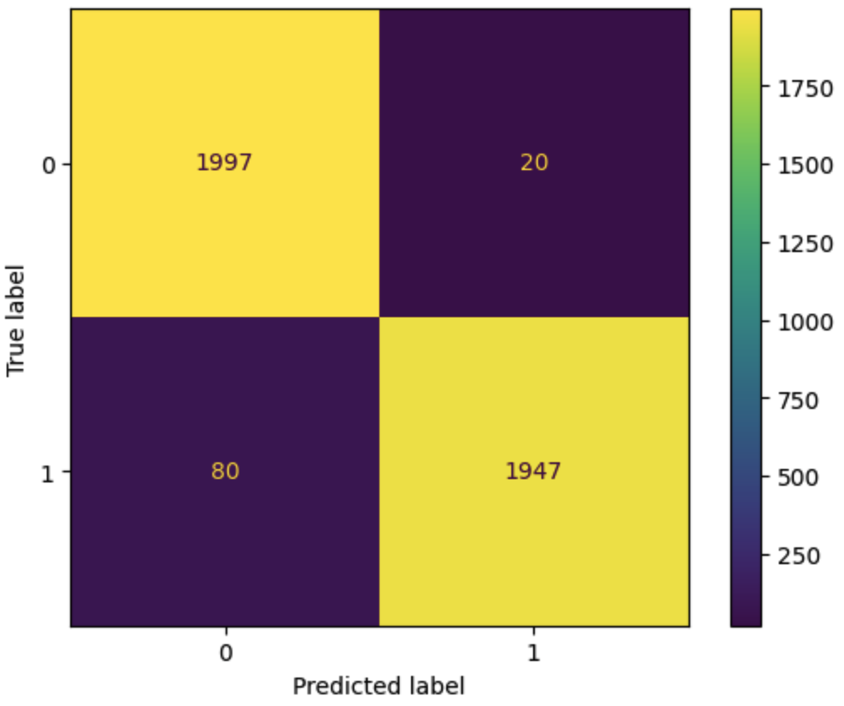
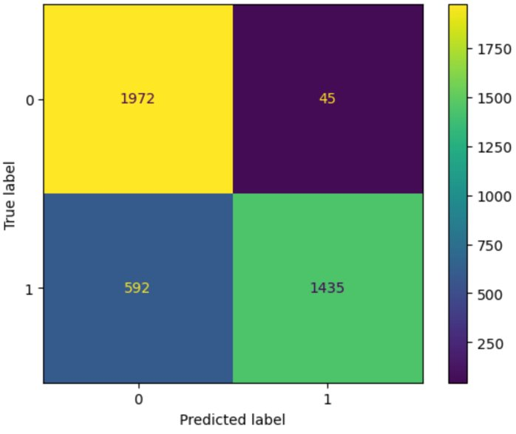
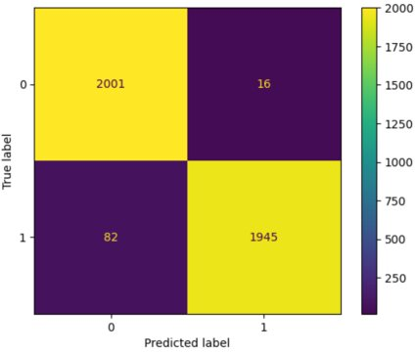
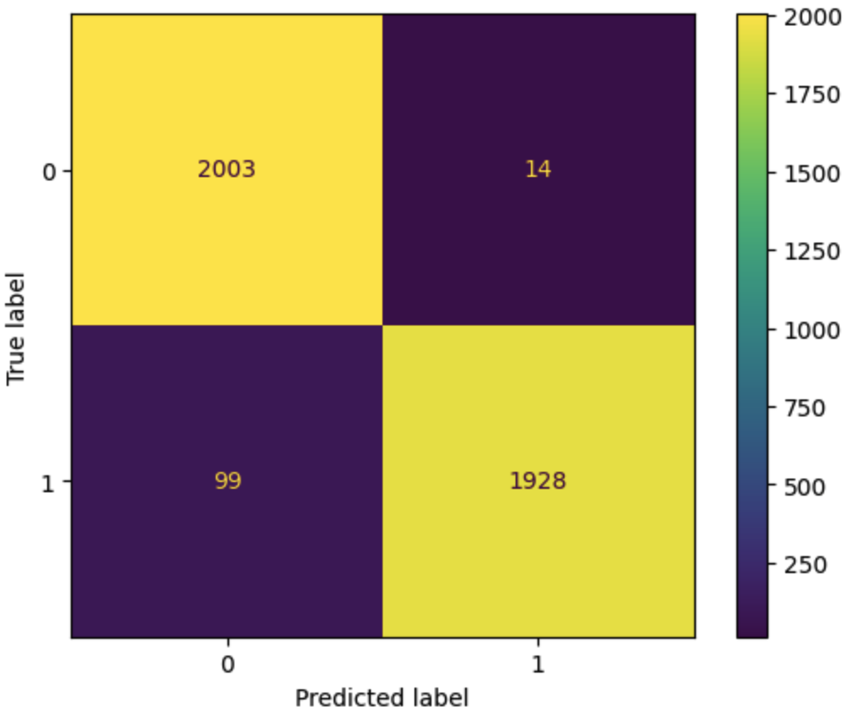
Model 1
Model 2
Model 3
Model 4

Slide 20
Analysis and Result
Model 2 exhibits the lowest accuracy due to its unique training approach. It increases the susceptibility to errors
The utilization of data based on cosine similarity to the validation set, coupled with predictions from Model 1, introduces a higher likelihood of errors.

Slide 21
Conclusion
Model 4 stands out as the most accurate, showcasing its effectiveness in detecting computer-generated reviews. However, its trade-off with precision suggests a careful consideration of the specific use case and priorities in model deployment .
Model 2, while presenting lower accuracy, serves as a valuable learning experience, highlighting the importance of real data in training for improved performance.
Notes:
In the context of this project, the choice is made to favor Model 3 as the optimal choice among the four models. Despite not achieving the highest score in detecting computer-generated reviews, Model 3 strikes a balance by achieving high scores in predicting human reviews and overall accuracy.

Slide 22

Thank You

